Slide 1
Gene-gene interactions in psychiatric diseases
An introduction to initial analysis of my PhD

Slide 2
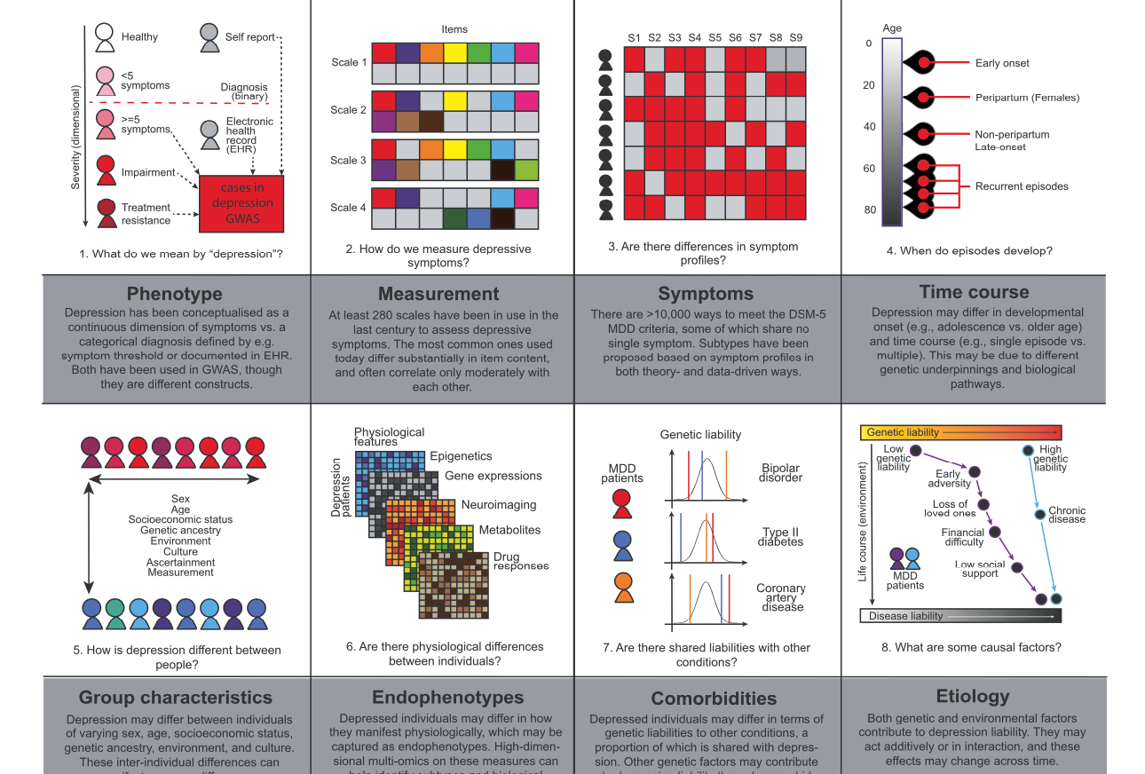
Psychiatric disease: depression
Notes:
Many cases, very little is understood
GWAS hits starting to pop up as databases grow, but pheontyping remains heterogeneous.
To identify subtypes of depression, GWAS on different depression phenotypes were done, most of which were minimal phenotypes: self-reports, questionaires and ‘‘using antidepressants‘‘ from a health record.
A colleague of mine is currently working on GWAS of individual depression symptoms.

Slide 3
Psychiatric disease: depression
Notes:
Many cases, very little is understood
GWAS hits starting to pop up as databases grow, but pheontyping remains heterogeneous.
To identify subtypes of depression, GWAS on different depression phenotypes were done, most of which were minimal phenotypes: self-reports, questionaires and ‘‘using antidepressants‘‘ from a health record.
A colleague of mine is currently working on GWAS of individual depression symptoms.

Slide 4
Gene gene itneractions
Notes:
The summary statistics of these GWASs will be helpful for me to use , as they are likely enriched in pathways that have an effect on the phenotype.
To determine whether different pathways are interacting in depression, I will intially apply Coordinated Interaction model on the whole of depression GWAS, as well as the individual symptomatic GWAS results if the initial analysis gives promising results.

Slide 5
Psychiatric disease: depression
Notes:
Many cases, very little is understood
GWAS hits starting to pop up as databases grow, but pheontyping remains heterogeneous.
To identify subtypes of depression, GWAS on different depression phenotypes were done, most of which were minimal phenotypes: self-reports, questionaires and ‘‘using antidepressants‘‘ from a health record.
A colleague of mine is currently working on GWAS of individual depression symptoms.

Slide 6
Coordinated interaction
Notes:
Gene-gene interaction, or epistasis models, assume no structure within the interaction, so that interaction is random.
Coordinated interaction will take structure into account. When y=0, no interaction has occured. Y<0 means pathwayA/pathwayB and y>0 means pathwayA * pathwayB
Assuming the phenotypes have an additive genetic structure.

Slide 7
Coordinated Interaction
Notes:
Split summary statistics into partitions of even and odd chromosomes
Calculate PRS for even and odd data partitions
Regress PRSe with PRSo to detect a non-zero interaction effect.
Calculate PRS over individual synptom datasets
Regress symptomA PRSe with symptom Bprs0 to detect interaction between symptom specific pathways, assuming symptom A GWAS is enriched for symptom specific pathways.

